Slide 1
CS542 Computer Networks 1 : Fundamentals Link State Routing Protocol Simulator
Jayanth Vangari
(A20337867)

Slide 2
Contents :
1. Introduction
2. Link State Routing Protocol
3. Algorithm
4. Methods Description
5. Screenshots
6. Conclusion
7. References

Slide 3
INTRODUCTION
The project simulates the link state routing protocol using Dijkstra’s algorithm
The project involves implementing of two functions using the Dijkstra’s algorithm.
1. Create a Forwarding Table for any selected node
2. Least Cost Path between any two selected nodes

Slide 4
Link State Routing Protocol:
The Link State Routing protocol is one of the main routing protocols that is used in packet switching networks.
The link-state protocol is performed by every node or router in the network.
In Link state routing protocol , every node in the network constructs a logical best path from it to every other possible destination node of the network.
Dijkstra’s algorithm, one the Link-state routing algorithms that is implemented in this project.

Slide 5
Algorithm :
Dijkstra’s algorithm is used to construct a sink tree that gives the minimum cost path from a node to every other node in the network.
The algorithm applied to simulate the link state protocol is as follows:
1 Initialization:
2 add x (source node) to M
3 for all nodes y
4 if y adjacent to x
5 then D(y) = cost(x,y)
6 else D(y) = -1
7 temp : =x
8 flag[x] =1 /* x is visited */
9 for all nodes y
10 flag[y]= 0 /* node is unvisited */
11 while list M is not full /* all nodes are not added to M */
12 For all nodes that are not visited yet

Slide 6
13 min : = node y with minimum D[y]
14 temp : = y
15 add temp to M
16 flag[temp]:= 1 /* node is visited */
17 for each neighbor y of temp that aren’t visited :
18 If min+cost(temp,y)<D(y)
19 D(y) = min+cost(temp,y) /* new cost to y is either old cost to y or know
20 shortest path cost to r plus cost from r to y */
21 predecessor[y]: = temp
22 end if
23 end for
24 end while
24 return predecessor [ ]

Slide 7
The above algorithm is used to implement the following two functions
1. creating a forwarding table for selected node.
2. Least Cost Path between any two nodes , source and destination nodes .
The project is implemented in java and it has 4 methods.
menu()
ForwardingTable()
leastCostPath()
Connection()

Slide 8
Methods description:
menu() : the menu method displays the menu containing the functions that are simulated in the project.
a. Forwarding Table
b. Least Cost Path between any two nodes.
forwardingTable(): creates a forwarding table for selected node, calls the connection() method
least cost Path(): computes the least cost path between source node and the destination node,calls the connection() method.
Connection(): This method implements the dijkstra’s algorithm used, and is called by both methods forwardingTable() and leastCostPath() , returns predecessor[ ]

Slide 9
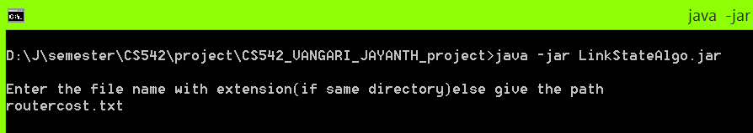
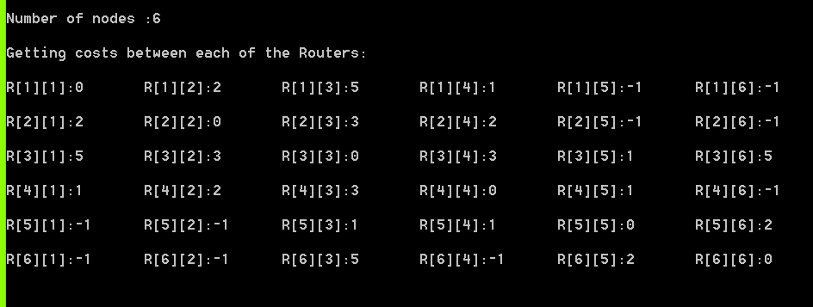
Screenshots :
routercost.txt
0 2 5 1 -1 -1
2 0 3 2 -1 -1
5 3 0 3 1 5
1 2 3 0 1 -1
-1 -1 1 1 0 2
-1 -1 5 -1 2 0

Slide 10
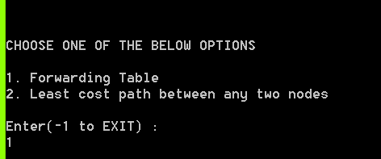
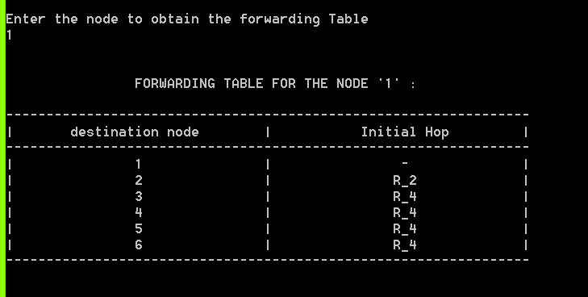
Menu :
Forwarding Table :

Slide 11
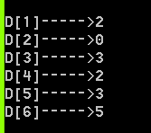
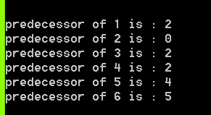
Connection() method:
Minimum costs from node ‘2’ to every other destination node
The connection() method implements the dijkstra’s algorithm and computes the least cost path from the node ‘2’ to every other destination node, and returns predecessor[] that is used by the leastCostPath() to trace back the path from destination node to source node.

Slide 12
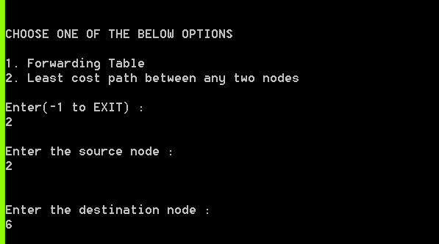
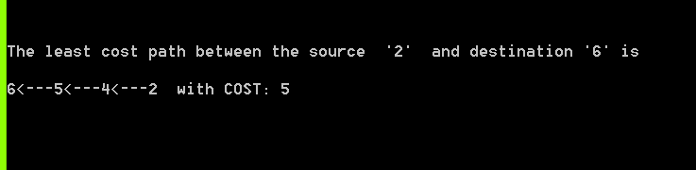
Least cost Path between 2 nodes :
Reading the user source node input and destination node input the method leastCostPath() outputs the least cost path from node ‘2’ to ‘6’ and its cost.

Slide 13
Conclusion :
The project simulates the link state routing protocol implementing both the functions
creation of forwarding table and
computing least cost path between any two nodes
The project works for arbitrary number of nodes given by the user.

Slide 14
References :
1. Computer Networking : A top – down approach by Kurose and Ross, Sixth Edition.
2. http://en.wikipedia.org/wiki/Dijkstra%27s_algorithm

Slide 15
THANK YOU ..!

